Slide 1
NACPO OVERVIEW & UPDATES
10 January 2012

Slide 2
Agenda
2011 Activities and Developments
2012 Initiatives and Goals
Questions

Slide 3
2011 Activities and Developments
IFR Kaizen
Cross functional team, goal of achieving Reduced IFRs
Continued Certification Approach
– Similar to ITE IFR approach – “Softlaunch” in select Standard(s) expected in early 2012 – UL Standards only
Key UL Mark Policy Documents Revised
Notes:
<>IFR Kaizen took place in September 2011 and team developed “Continued Certification Approach” proposal. Proposal has Core Team support and processes being refined for Softlaunch in 2012. Proposal is limited to UL Standards only, i.e. no CSA, NSF or other non-UL Standards. Deviation document under review for publication for Softlaunch. Traditional IFR approach will continue to be an option.
<>Key UL Mark Policy Documents Revised in 2011. UL Mark Program - Descriptions of Programs (00-CE-P0002) was deleted and other policy documents reference UL Master List of Programs. This document provided general descriptions of the various certification programs, ancillary programs, and services that are included in the UL Mark Program. The Repackage Program, Retrofit Program and Rebuilt Program SOPs are referenced by Certification Decision Policy SOP (00-CE-P0005). Revisions to other documents are noted in the following slides…

Slide 4
2011 Activities and Developments
Authorization for Applicant to Reproduce Report
Staff Competency for L3’s/L4’s
Optimized SNAP/NRTL Site Classification
Financial analysis → no changes in Recognized/SNAP sites
Acquired Laboratories (e.g. AQS & Springboard)
Since they are not fully integrated in UL’s system, may not follow GTLP
Option to continue under DAP or incorporate their processes in GTLP
New policy document under development (2012 NACPO Goal)
Notes:
<>Authorization for Applicant to Reproduce Portion of Listing/Classification Reports – Customer request for UL to consider a change in policy concerning the copying of UL Reports. UL Reports are copyrighted, and Applicants are not allowed to copy them or provide them to anyone else except under the following rules as described in 00-OP-S0067 section 130.7.3 and other sections of that document.
UL Recognized Components: a) The entire Report, including Description, can be copied; or, b) The Report can be copied to include information only through the Conditions of Acceptability section.
UL Listed Products: The entire Report must be copied.
Status → in progress; Legal review
<>Staff Competency for L3’s/L4’s – A new concept is under discussion to address competency that will utilize continual development versus end-dating and recertification. PDE org is facilitating this effort, and several actions have been identified for moving from the current L3/L4 recertification approach to this new continual development approach. This will be for L3 competencies only.
<>Optimized SNAP/NRTL Site Classification – Analysis completed which evaluated the financial aspects of changing the balance of UL NRTL and SNAP sites. Conclusion resulted in maintaining current status of NRTL sites.
<>Acquired Laboratories (ATLDP) - A new “Acquired Test Laboratory Data Program” (ATLDP) document, which will be similar to the current TPTDP document, is under development to address these acquired labs that may not be ready to fully comply with the Global Testing Laboratory Policy criteria.

Slide 5

2011 Activities and Developments
Record Retention
Some records no longer require indefinite storage retention (e.g. NOA, ATL). 00-CE-S0030 to be revised shortly.
FUS Sample Testing
Agreement to allow DAP CTDP Participant to perform their own FUS Sample testing
DAP policy & FUS Sample Test Process docs under revision
Notes:
<>Record Retention – Legal has clarified their position on record retention in relaxing the permanent storage requirements for some records. The MPC determined that it is not essential to retain some records. NOA is only a temporary authorization that is needed until the final Procedure and Report are made available (usually less than one day following the certification decision). Another example is the ATL, which is kept for about 6 months and then purged. Record Retention policy to be revised shortly.
<>FUS Sample Testing - A discrepancy in policy and process documentation on allowing FUS sample testing at client facilities. 00-OP-S0067 states that FUS sample testing at client facilities is not allowed. DAP Policy allows this testing; however it requires authorization by FUS and the retention of records of this authorization (clause 9.1). It is believed, in the past, select clients were allowed to perform some of these tests. The MPC decided that it is acceptable for any DAP participant including CTDP to also perform FUS sample testing, if such testing is included in their DAP scope. Actions underway for DAP Policy and related documents to state that any DAP participant can perform FUS sample testing

Slide 6
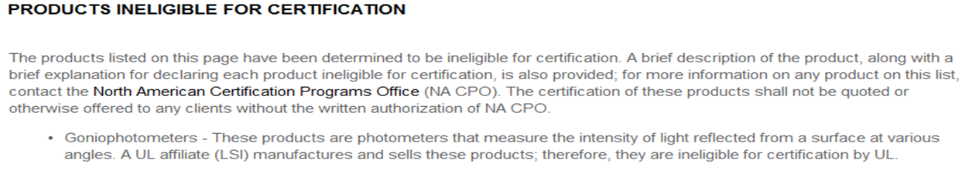
2011 Activities and Developments
Provisional Certification
List of categories and tests on NACPO webpage
Products Ineligible for Certification (on NACPO webpage)
Authorization Page Revisions
Embedded hyperlinks to the subscriber and UL responsibilities documents on UL.com
Addresses ANSI NCR dealing with UL subscribers executing GSA
Notes:
<>Provisional Certification – NACPO Webpage contains list of authorized categories and tests deemed appropriate.
Products Ineligible for Certification – To address any potential accreditation concerns with acquisitions engaged in product manufacturing, this page identifies products or categories that UL will not certify. CS staff and others have been advised.
Authorization Page Revisions - There have been numerous ANSI findings concerning clients that do not have a valid agreement on file. The fact that we point to the various contractual agreements to satisfy certain ISO/IEC Guide 65 requirements opens the agreement records to auditing by our accreditors such as ANSI. The ANSI findings were further justification for efforts to modify the Authorization Page. Other processing improvements were requested to address items such as the LMDP, 2nd Century text, and more details concerning subscriber identification. The new Authorization Page will contain a hyperlink to a new webpage containing the UL and client responsibilities to satisfy ISO/IEC Guide 65. It is intended to invoke the agreement by the client to abide by the responsibilities through the client’s use of the Mark, their payment of fees, or their allowing the Field Representative to enter their facility. This concept has been presented to ANSI, and it was accepted as a potentially viable option.

Slide 7
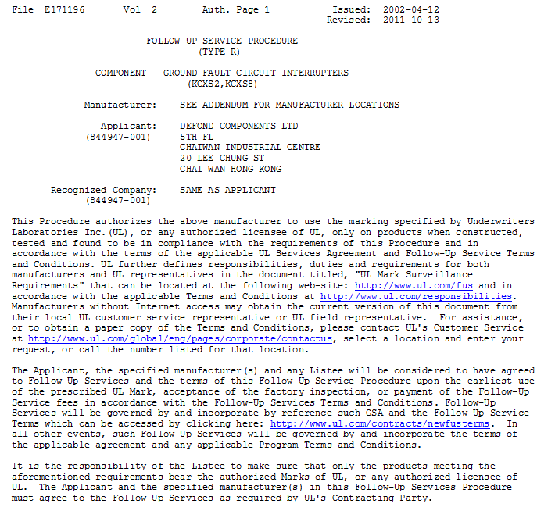
2011 Activities and Developments
example
Notes:
New Authorization Page example

Slide 8
Agenda
2011 Activities and Developments
2012 Initiatives and Goals
Questions

Slide 9
2012 Initiatives and Goals
<>Review Component Acceptance & Unlisted Component Policies
<>Convergence of UL Mark and ULC Mark Programs
<>Develop New DAP Policy for Acquired Test Labs
<>Compare UL Mark Policy with Accreditation Requirements
<>Revise Lab Policy Hierarchy and Validate Compliance with 17025 Std
<>Gap Analysis of UL Mark Policy documents w.r.t. DIS 17065 Std
<>2011 AMRs’ of UL Mark Programs underway
IQA Audits is key AMR input

Slide 10
THANK YOU.
Questions…

